Slide 1
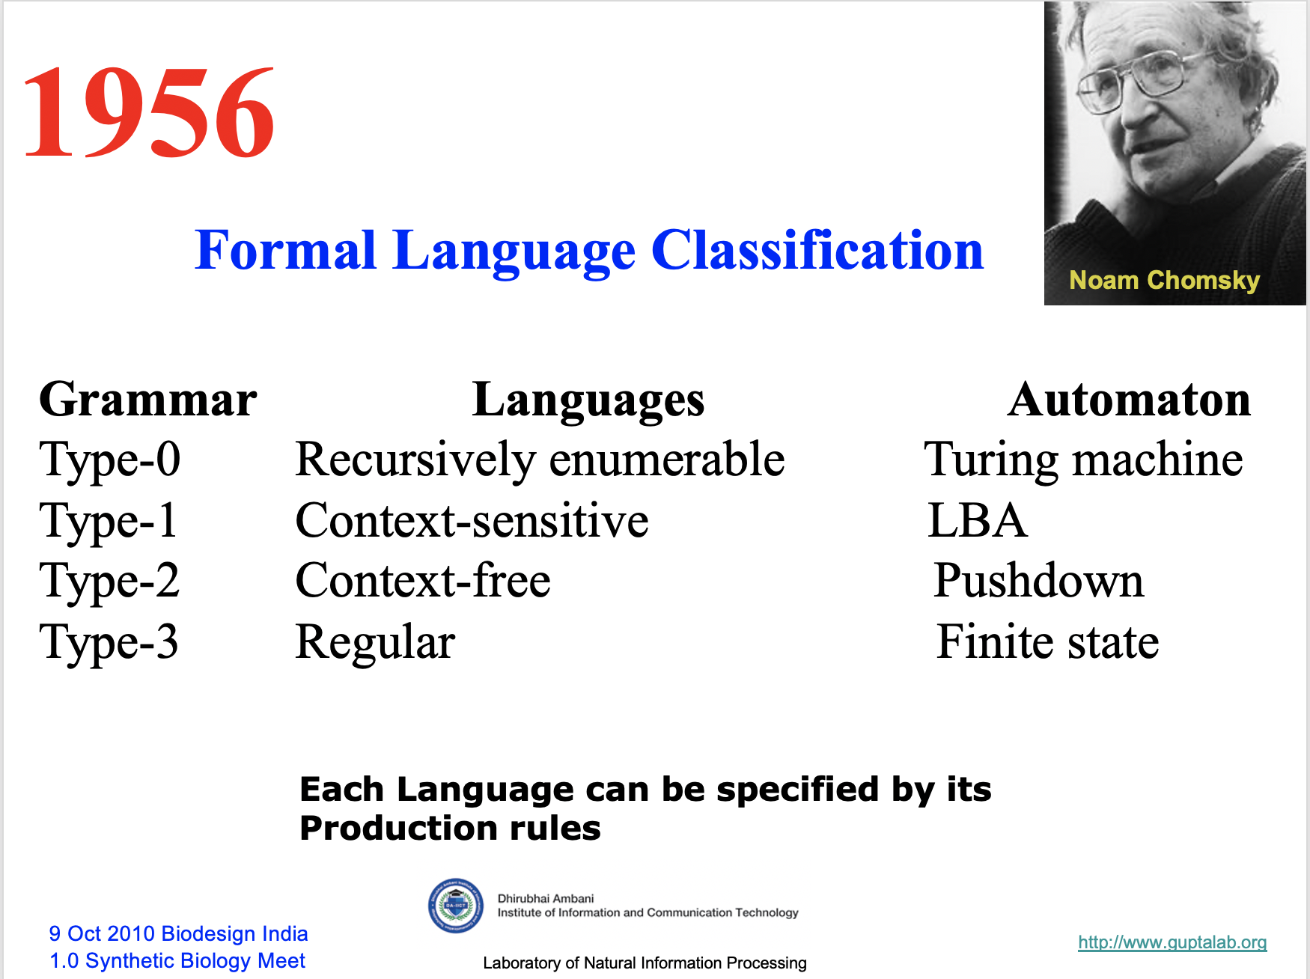

s
Prof. Busch - LSU

Slide 2
Properties of
Regular Languages
Slides: Konstantin Busch, LSU
https://cse.lsu.edu/~busch/courses/theorycomp
Prof. Busch - LSU

Slide 3




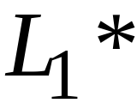
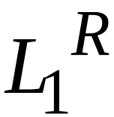


For regular languages and
we will prove that:
Union:
Concatenation:
Are regular
Languages
Star:
Reversal:
Complement:
Intersection:
Prof. Busch - LSU

Slide 4
We say: Regular languages are closed under
Union:
Concatenation:
Star:
Reversal:
Complement:
Intersection:
Prof. Busch - LSU

Slide 5



A useful transformation: use one accept state
NFA
2 accept states
Equivalent
NFA
1 accept state
Prof. Busch - LSU

Slide 6
In General
NFA
Equivalent NFA
Single
accepting
state
Prof. Busch - LSU

Slide 7
Extreme case
NFA without accepting state
Add an accepting state
without transitions
Prof. Busch - LSU

Slide 8
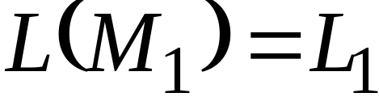
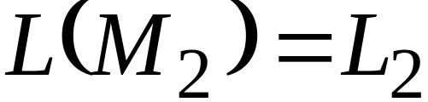


Take two languages
Regular language
Regular language
NFA
NFA
Single accepting state
Single accepting state
Prof. Busch - LSU

Slide 9

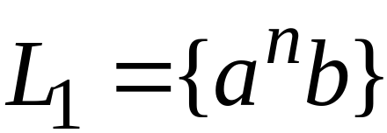
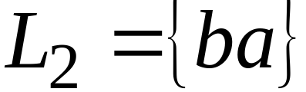
Example
Prof. Busch - LSU

Slide 10
Union
NFA for
Prof. Busch - LSU

Slide 11
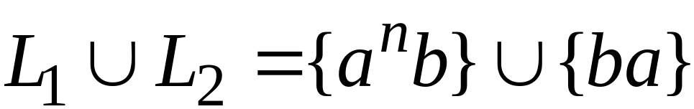
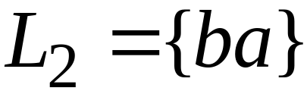
Example
NFA for
Prof. Busch - LSU

Slide 12
Concatenation
NFA for
Prof. Busch - LSU

Slide 13
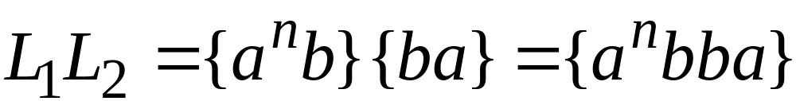
Example
NFA for
Prof. Busch - LSU

Slide 14
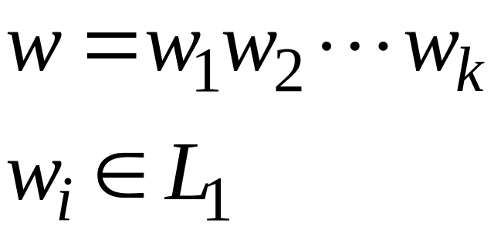
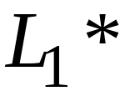
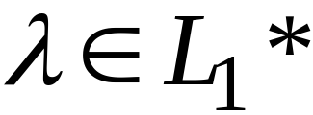
Star Operation
NFA for
Prof. Busch - LSU

Slide 15
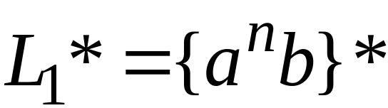
Example
NFA for
Prof. Busch - LSU

Slide 16

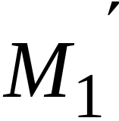
Reverse
NFA for
1. Reverse all transitions
2. Make initial state accepting state
and vice versa
Prof. Busch - LSU

Slide 17
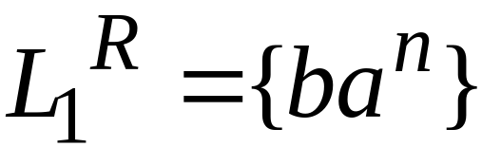
Example
Prof. Busch - LSU

Slide 18
Complement
1. Take the DFA that accepts
2. Make accepting states non-final,
and vice-versa
Prof. Busch - LSU

Slide 19

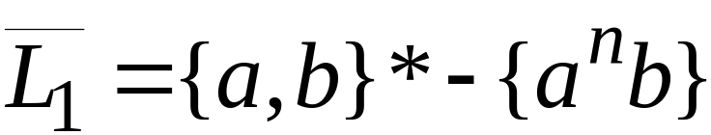
Example
Prof. Busch - LSU

Slide 20
Intersection
regular
We show
regular
regular
Prof. Busch - LSU

Slide 21




DeMorgan’s Law:
regular
regular
regular
regular
regular
Prof. Busch - LSU

Slide 22
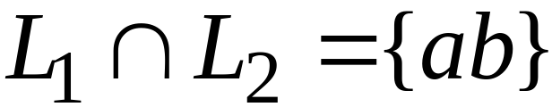
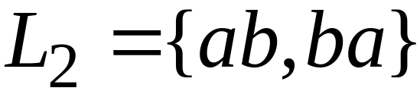
Example
regular
regular
regular
Prof. Busch - LSU

Slide 23

Another Proof for Intersection Closure
Machine
Machine
DFA
for
DFA
for
Construct a new DFA that accepts
simulates in parallel and
Prof. Busch - LSU

Slide 24

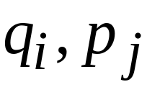
States in
State in
State in
Prof. Busch - LSU

Slide 25




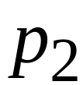
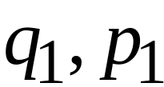
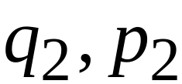
DFA
DFA
transition
transition
DFA
New transition
Prof. Busch - LSU

Slide 26

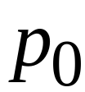
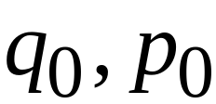
DFA
DFA
initial state
initial state
DFA
New initial state
Prof. Busch - LSU

Slide 27



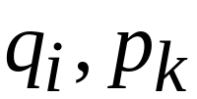
DFA
DFA
accept state
accept states
DFA
New accept states
Both constituents must be accepting states
Prof. Busch - LSU

Slide 28

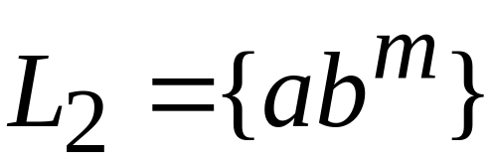








Example:
Prof. Busch - LSU

Slide 29
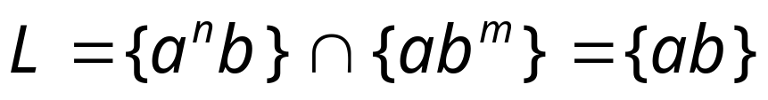







Automaton for intersection
Prof. Busch - LSU

Slide 30


simulates in parallel and
accepts string
if and only if:
accepts string
and accepts string
Prof. Busch - LSU

